Slide 1
Lesson objective
Title: Fraction, decimal and percent
Aim – to be able to:
convert Fractions Decimals and Percentages using appropriate methods.
PBiS focus
- Being appropriate in class.

Slide 2
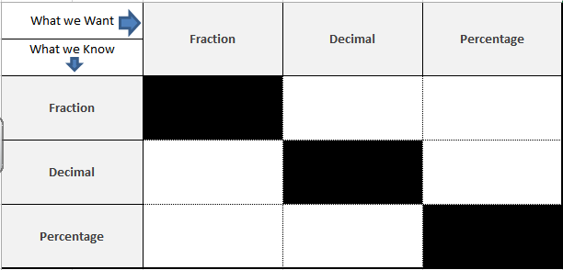
Conversion help sheet – notes page

Slide 3
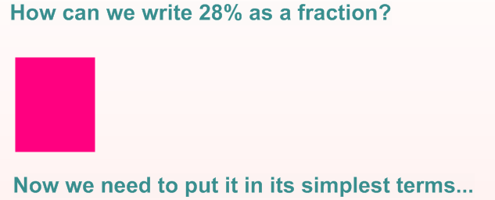
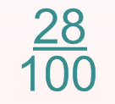

Percentages to Fractions
$$\frac{7}{25}$$

Slide 4
Conversion help sheet
Put over 100 and then simplify by dividing by common factors

Slide 5
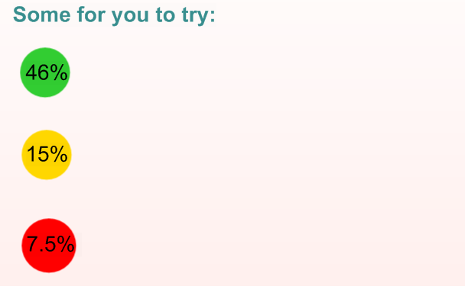

Slide 6
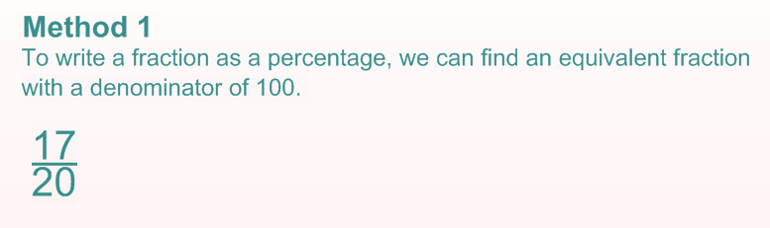
Fraction to a Percentage

Slide 7
Conversion help sheet
Create an equivalent fraction with a denominator of 100
Put over 100 and then simplify and then simplify then simplify by dividing by common factors

Slide 8
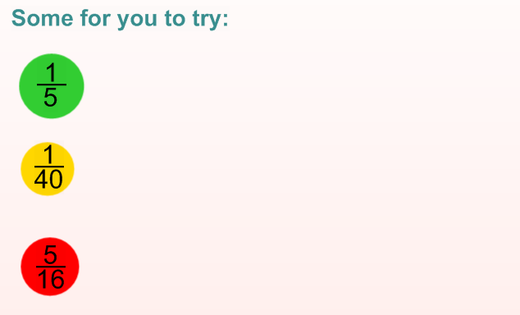

Slide 9
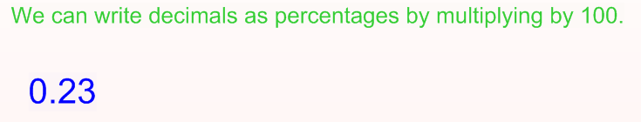
Decimal to a Percentage

Slide 10
Conversion help sheet
Create an equivalent fraction with a denominator of 100
X 100 (Multiply by 100)
Put over 100 and then simplify and then simplify then simplify by dividing by common factors

Slide 11
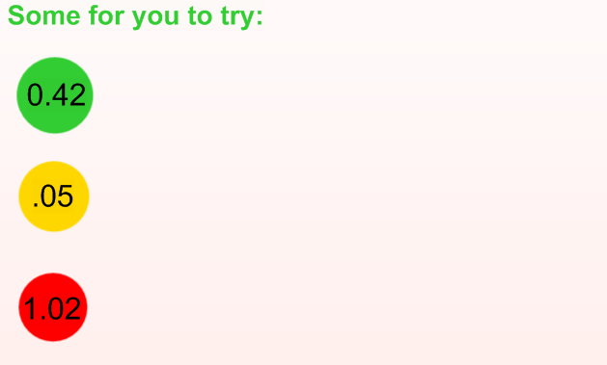

Slide 12
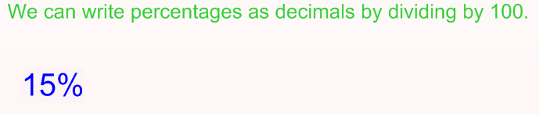
Percentage to a Decimal

Slide 13
Conversion help sheet
Create an equivalent fraction with a denominator of 100
X 100 (Multiply by 100)
Put over 100 and then simplify and then simplify then simplify by dividing by common factors
÷ 100 (Divide by 100)

Slide 14
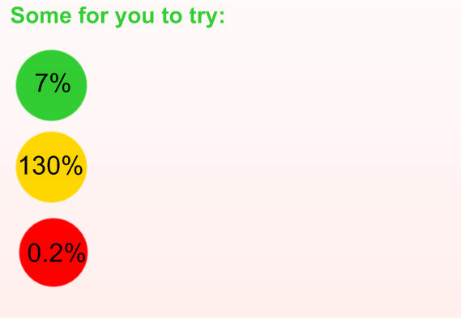

Slide 15
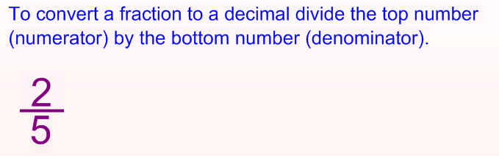
Fraction to a Decimal

Slide 16
Conversion help sheet
Numerator ÷ Denominator (Bus-stop method)
Create an equivalent fraction with a denominator of 100
X 100 (Multiply by 100)
Put over 100 and then simplify and then simplify then simplify by dividing by common factors
÷ 100 (Divide by 100)

Slide 17
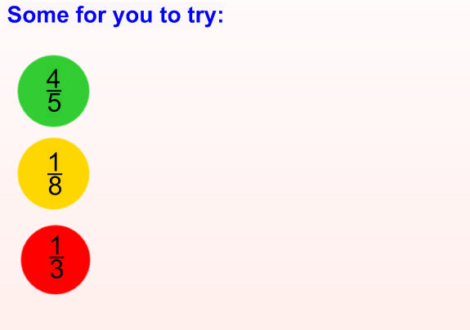

Slide 18
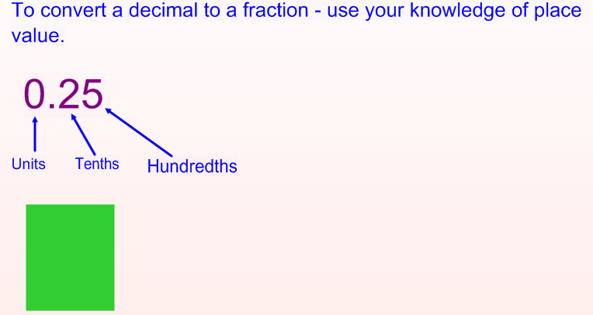

Decimal to a Fraction

Slide 19
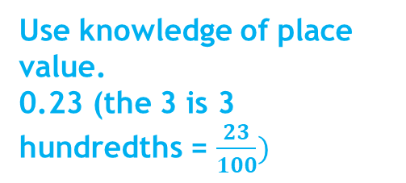
Conversion help sheet
Numerator ÷ Denominator (Bus-stop method)
Create an equivalent fraction with a denominator of 100
Use knowledge of place value. 0.23 (the 3 is 3 hundredths = $\frac{23}{100})$
X 100 (Multiply by 100)
Put over 100 and then simplify and then simplify then simplify by dividing by common factors
÷ 100 (Divide by 100)

Slide 20
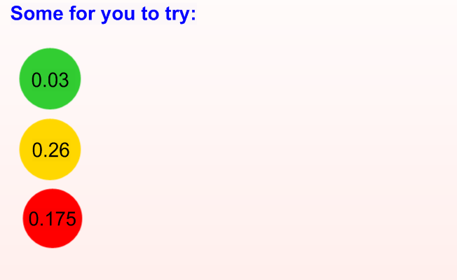

Slide 21
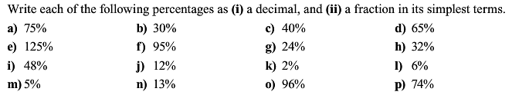
Percentages Conversions i) Turn into a decimal ii) Turn into a fraction and simplify

Slide 22
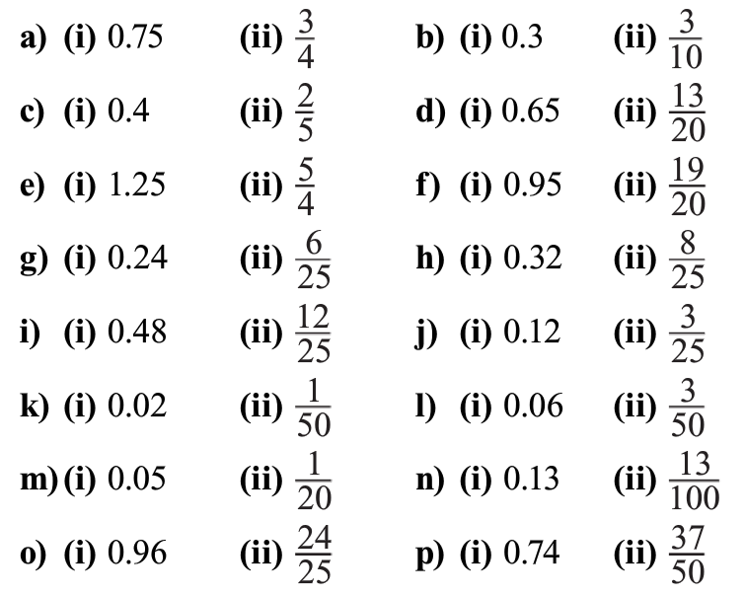
Answers

Slide 23
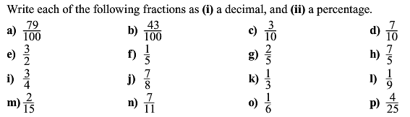
Fractions Conversions i) Turn into a decimal ii) Turn into a percentage

Slide 24
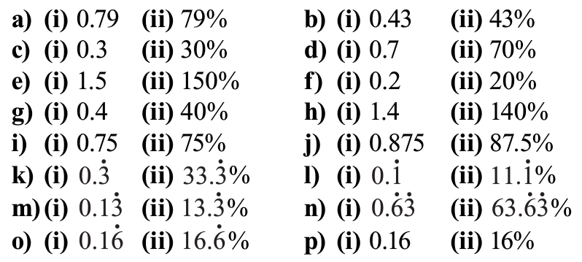
Answers

Slide 25
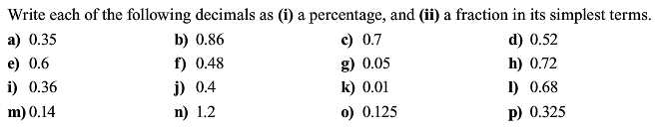
Decimals Conversions i) Turn into a percentage ii) Turn into a fraction and simplify

Slide 26
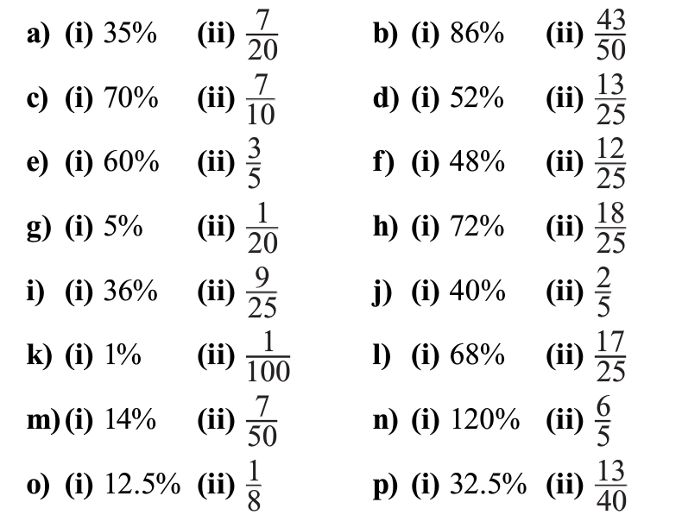
Answers

Slide 27
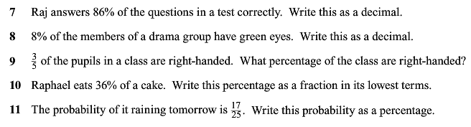
Worded Questions

Slide 28
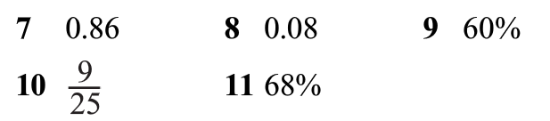
Answers

